Slide 1


SECURE SOFTWARE DEVELOPMENT (SSD)
Diploma in CSF
Academic Year (AY) 20/21 – Semester 3 (April `20)
Week 12
Web application Vulnerabilities II
Last Updated: 30/06/2020

Slide 2
Contents
Remote Learning Instructions
Mission 12.2: Cross Site Request Forgery Attack.
Ethical Considerations
Computer Misuse (Chapter 50A) and Cybersecurity Act
Mission 12.1: Cross Site Scripting (XSS)
Common Vulnerabilities
SQL Injection

Slide 3
Remote Learning Instructions
Step 1
Read the following slides:-
Ethical Consideration (Slide 4)
Computer Misuse (Chapter 50A) and Cybersecurity Act (Slides 5-6)
Step 2
Read Common Vulnerabilities (Slide 7-8)
Launch Mutillidae (Slides 9-11)
Step 3
Do Mission 12.1 – Cross Site Scripting
More details in slide 13-14
Step 4
Do Mission 12.2 – Cross Site Request Forgery
More details in slide 16-20
Do Reflection Journal (Slide 26)
Step 5
Understand SQL Injection (Slide 21)

Slide 4
Ethical considerations
As a student in ICT, you may have acquired certain knowledge and skills related to breaking, hacking or penetrating into programs, networks or systems as well as having access to security related tools.
You must use these knowledge and skills in an ethical and professional manner.
The School will not be responsible for your action(s) in the event you use these knowledge and skills inappropriately. You must take full responsibility for your own actions.

Slide 5
Computer Misuse (Chapter 50A) and Cybersecurity Act of Singapore
From this section onwards you would be attempting some of the OWASP Top 10 vulnerabilities on a deliberately vulnerable website called Mutillidae inside your own computer. You are not allowed to use these skills on any real/production/live websites or web applications.

Slide 6
Computer Misuse (Chapter 50A) and Cybersecurity Act
The Computer Misuse (Chapter 50A) Part 2 identified 8 offences:
Unauthorized access to computer materials
Access with intent to commit or facilitate commission of offense
Unauthorized modification of computer materials
Unauthorized use or interception of computer service
Unauthorized disclosure of access code
Unauthorized obstruction of use of computer
Enhanced punishment for offences involving protected computers
Abetments and attempts punishable as offences
A person convicted any of the above offences shall be liable to a fine not exceeding $100,000 or imprisonment for a term not exceeding 20 years or both.
Details: https://sso.agc.gov.sg/Act/CMA1993, https://sso.agc.gov.sg/Acts-Supp/9-2018/

Slide 7
Common Vulnerabilities
It is of utmost importance to understand and appreciate common software vulnerabilities that result in the compromise of computer assets, no matter what the programming languages used in the software.
Having good understanding of the software vulnerability enables one to better apply productive countermeasures.
There is no better way to understand the software vulnerability in depth, other than to experience it first hand.

Slide 8

Common Vulnerabilities
Click on link below to read the following common vulnerabilities:-
Cross Site Scripting I
Cross Site Scripting II
Cross Site Request Forgery

Slide 9
Launch Mutillidae
Experience cross-site scripting and cross site request forgery in OWASP Mutillidae II.
OWASP is a free, open source, deliberately vulnerable web-application with dozens of vulnerabilities and hints to help users understand the vulnerabilities better.
Launch Mutillidae now to learn about cross-site scripting and cross site request forgery.
Further reading: https://sourceforge.net/projects/mutillidae/

Slide 10
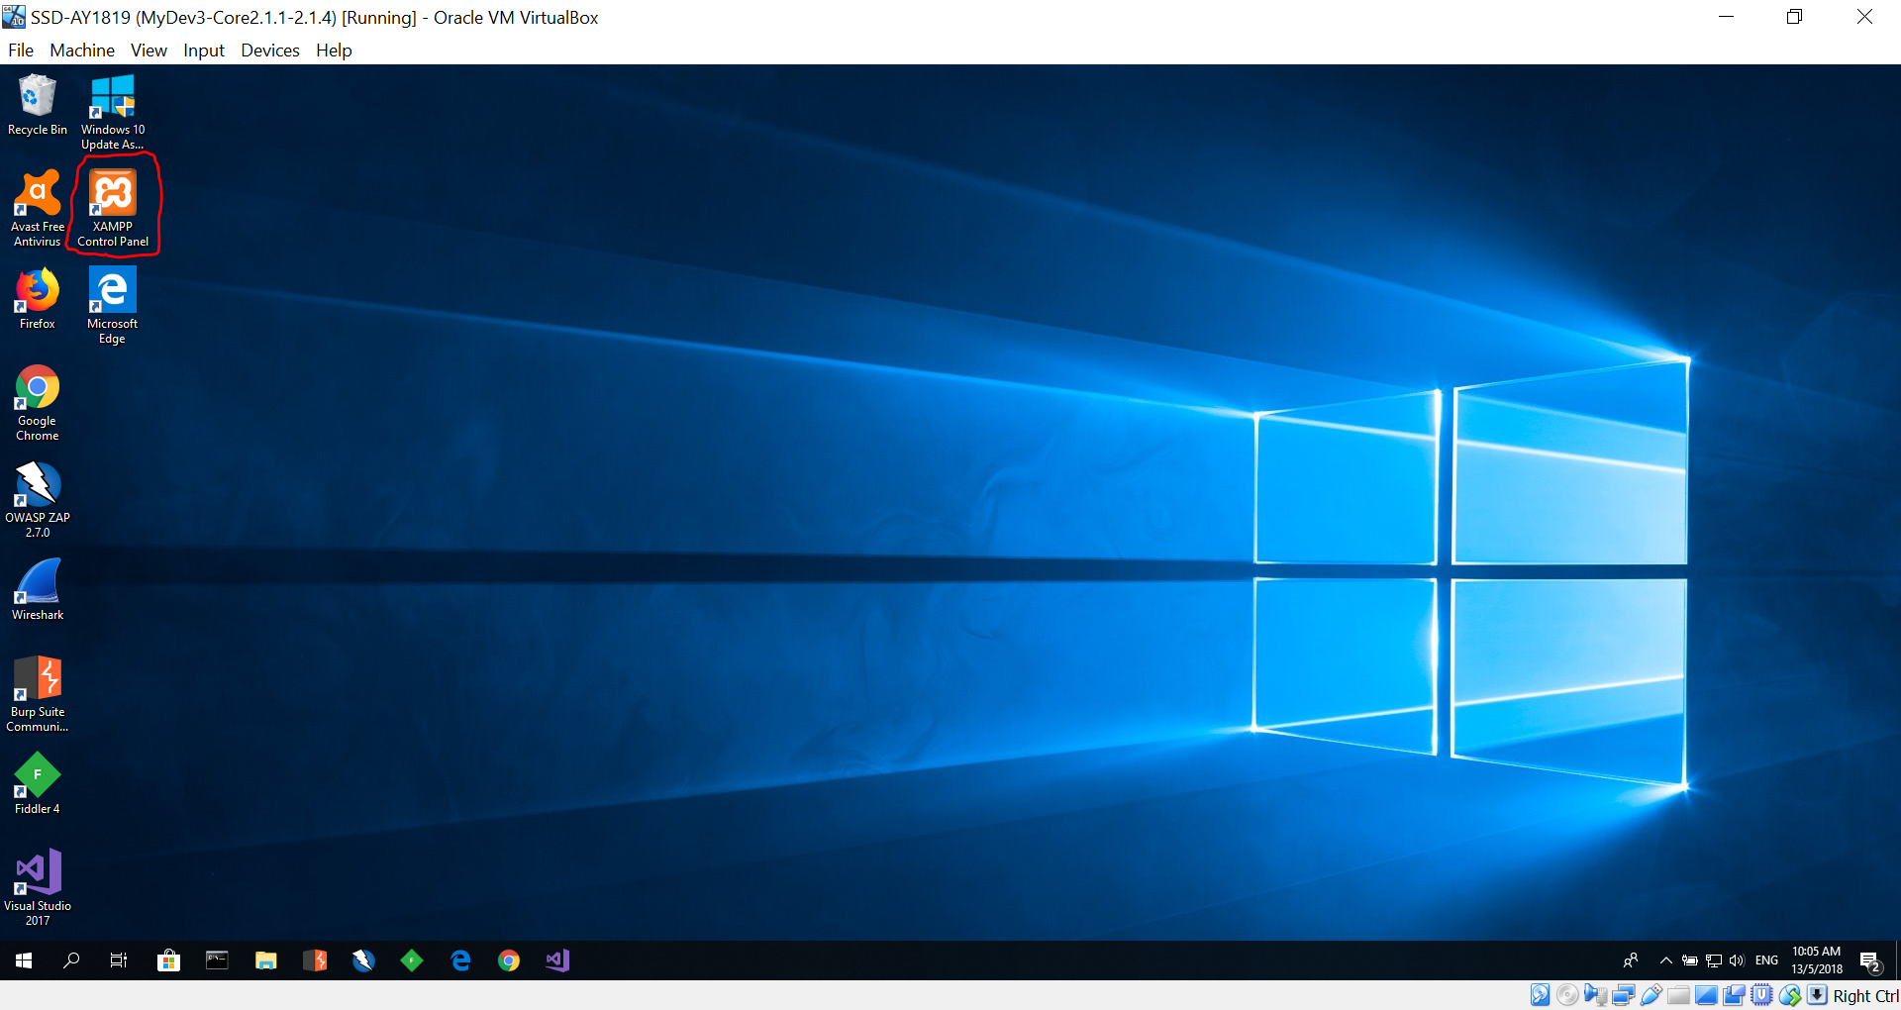
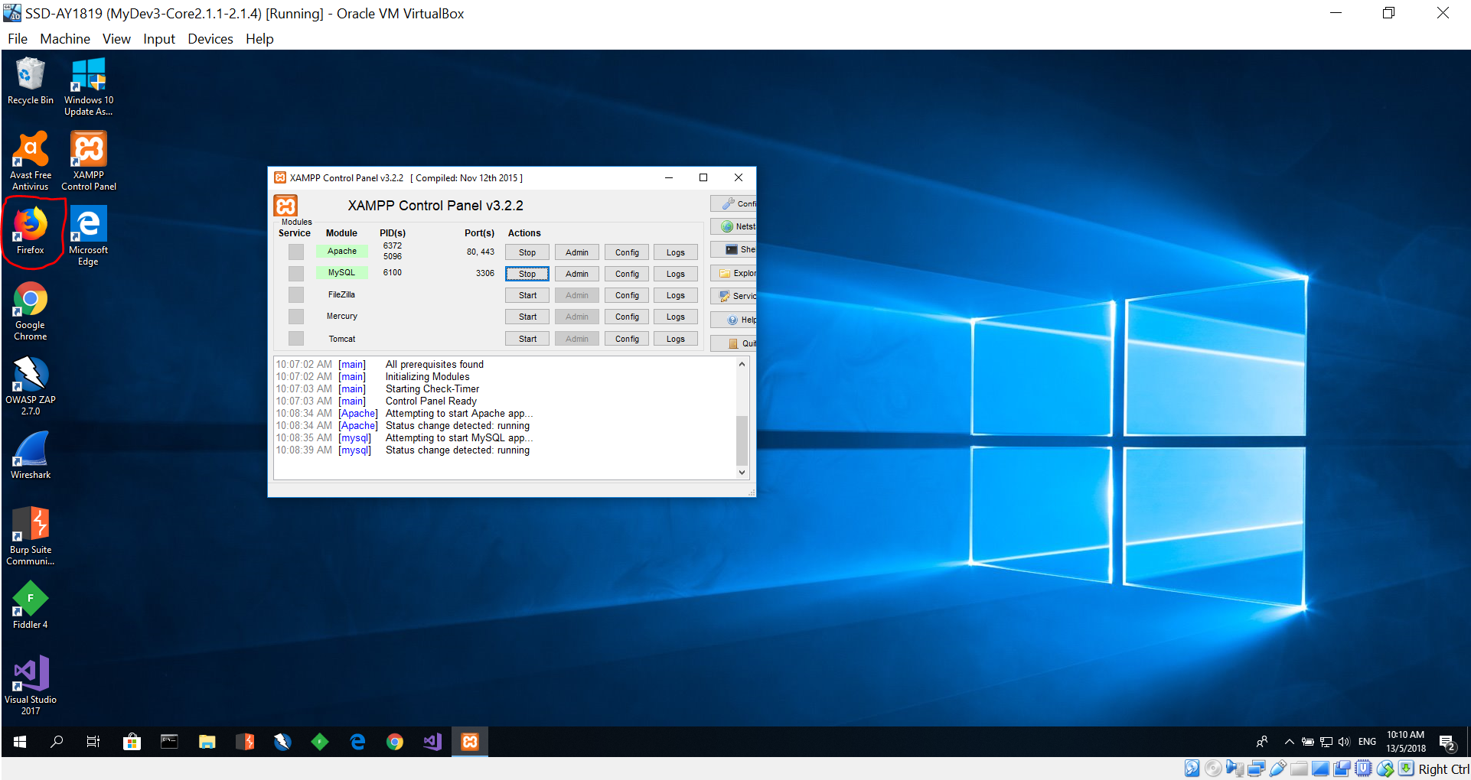
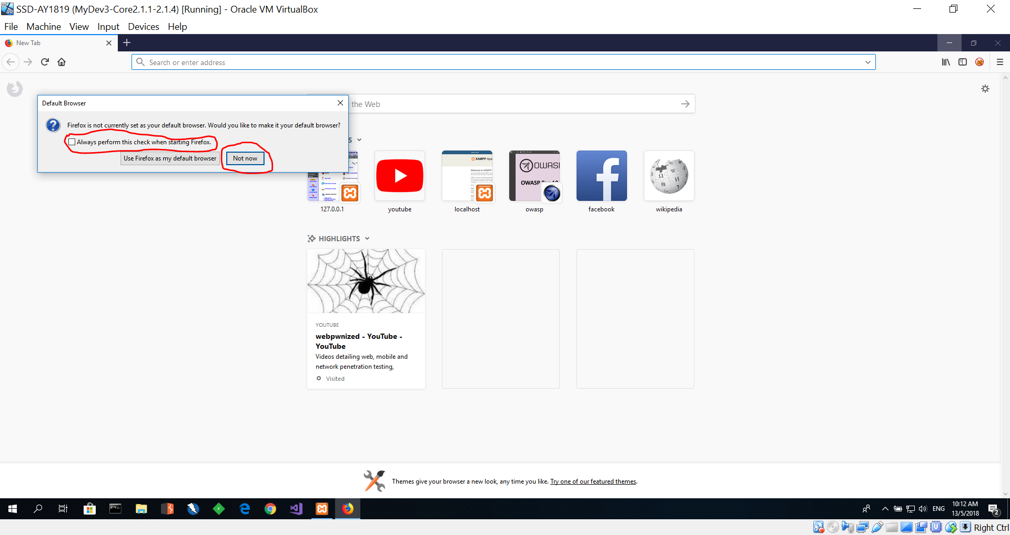
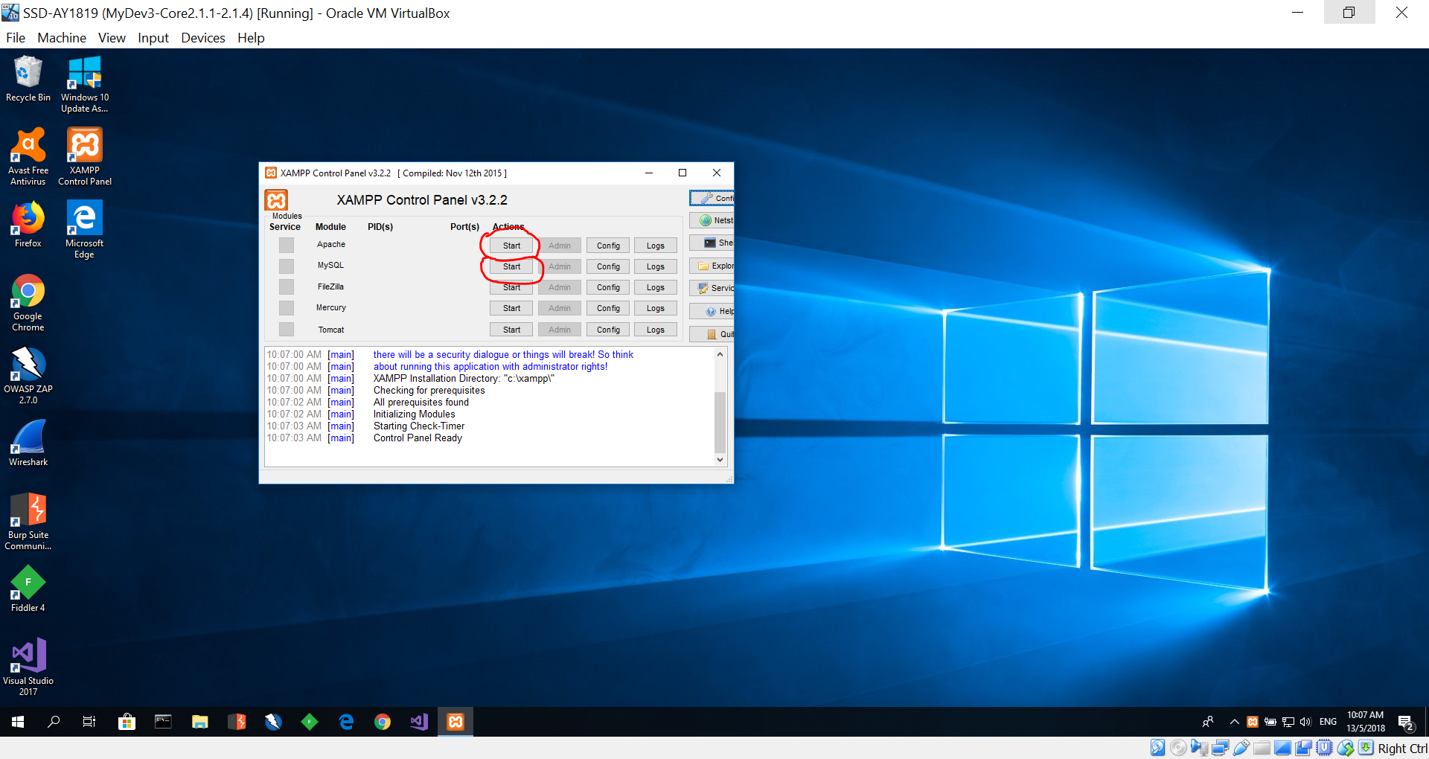
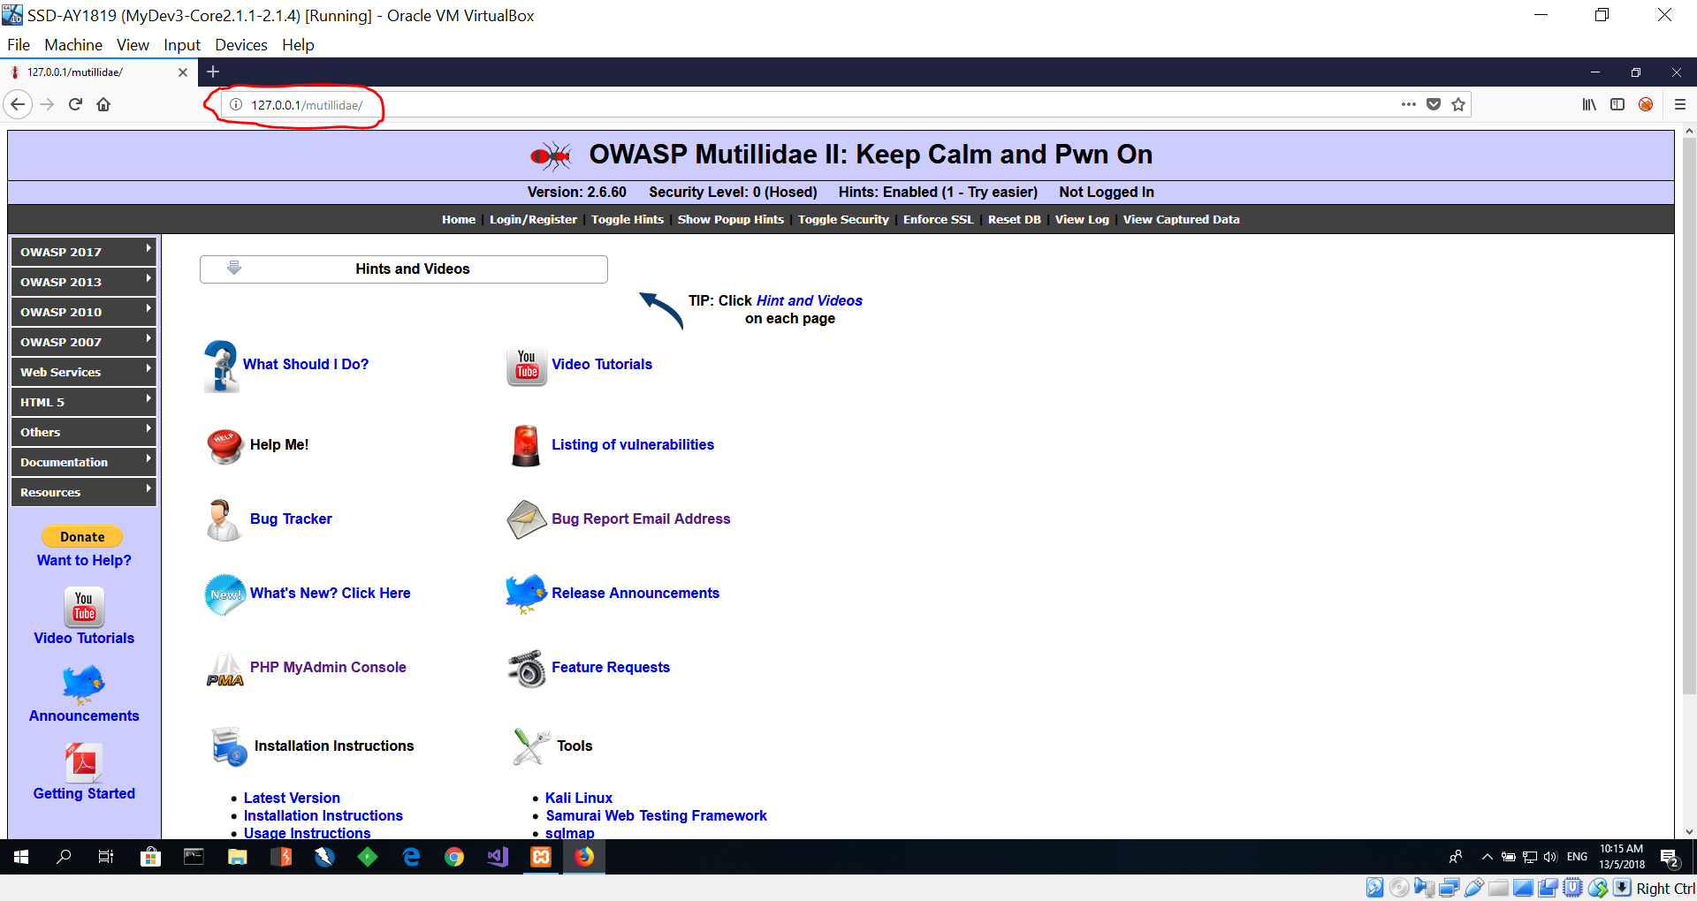
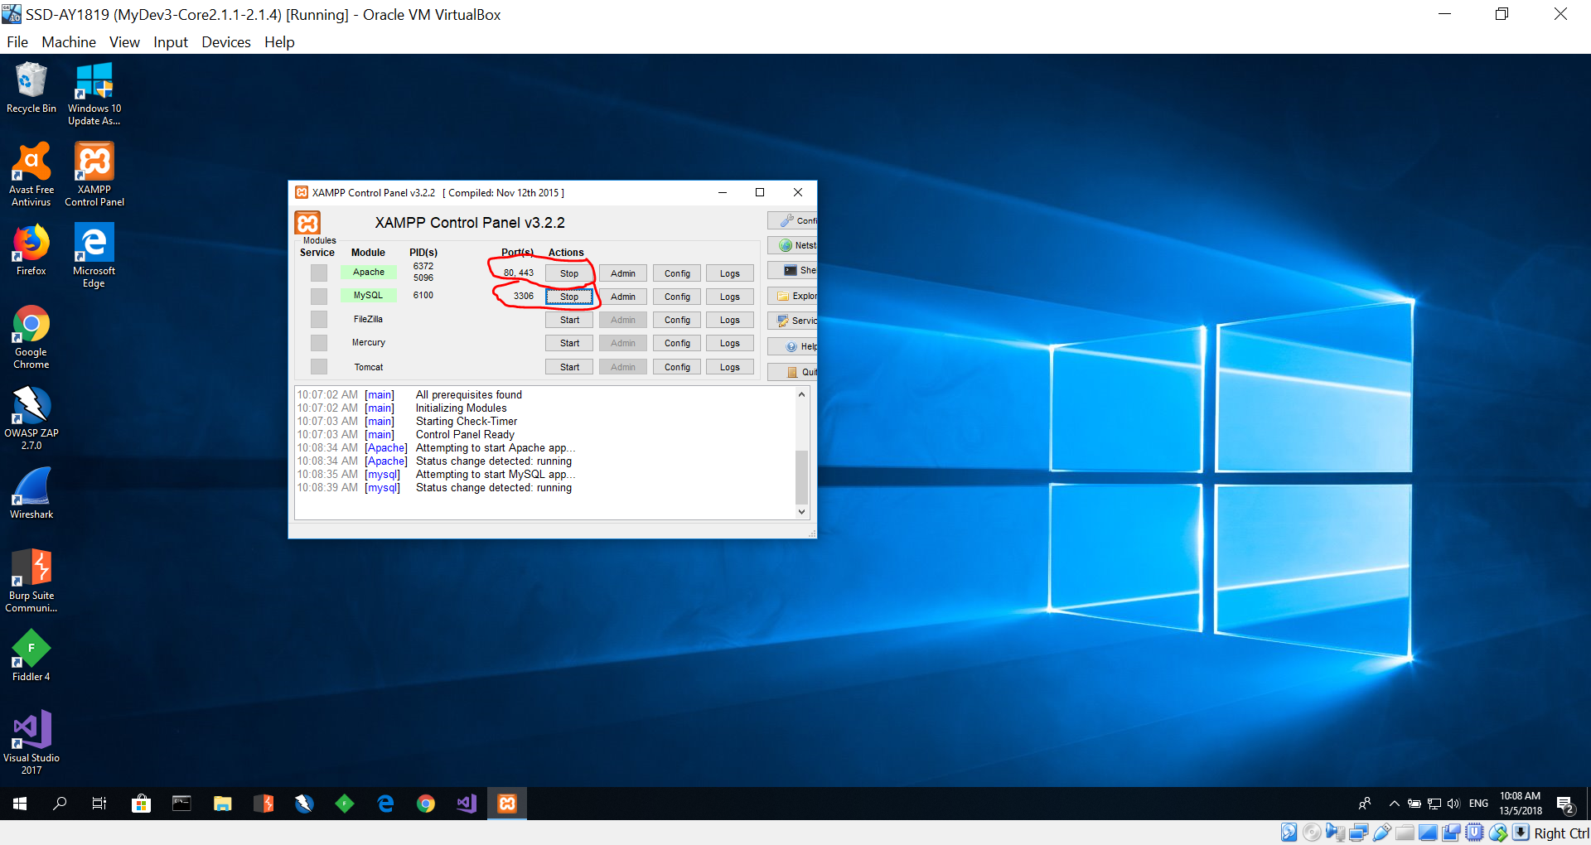
Launch Mutillidae – Inside Virtual Image
4
2
1
3
5

Slide 11
Setup (Optional) - Only for those who are not using the provided Virtual Image.
Download and install XAMPP server.
URL: https://www.apachefriends.org/download.html
Tutorial to install: https://youtu.be/aAtrpWBza9A
Download the latest version: 7.2.4 / PHP 7.2.4
After installing click on "start" buttons next to "Apache" and "MySQL".
If these two services cannot start due to port conflict, please follow this video and change the http port to 8880 and ssl port to 4443.
https://www.youtube.com/watch?v=AWtL1tSQVMk
Download latest version of “OWASP Mutillidae II”
URL: https://sourceforge.net/projects/mutillidae/files/latest/download
Unzip the downloaded file.
Copy and paste the "Mutillidae" folder in to xampp --> htdocs folder
Lauch your browser
Type: http://127.0.0.1/mutillidae
If you changed your ports type: http://127.0.0.1:8880/mutillidae
Click on "Reset DB".
Click "OK".
You should now be able to view Mutillidae website.

Slide 12

Cross Site Scripting (XSS)
A7 – Cross-Site Scripting (XSS)
https://youtu.be/IuzU4y-UjLw

Slide 13
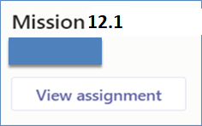
Mission 12.1
Task:
View the following videos:-
https://youtu.be/3pXeSkM7m3M - Video 1
https://youtu.be/k91UNRymD0U - Video 2
https://youtu.be/I0SusAlT1wY - Video 3
In your own words, write a report in word document of :-
What are the vulnerabilities shown in Video 2 & 3?
Explain how are the vulnerabilities in Video 2 & 3 different from one over the other?
Submit your report in MEL assignment link.
Deadline: End of Week 12
Penalty for late submission

Slide 14
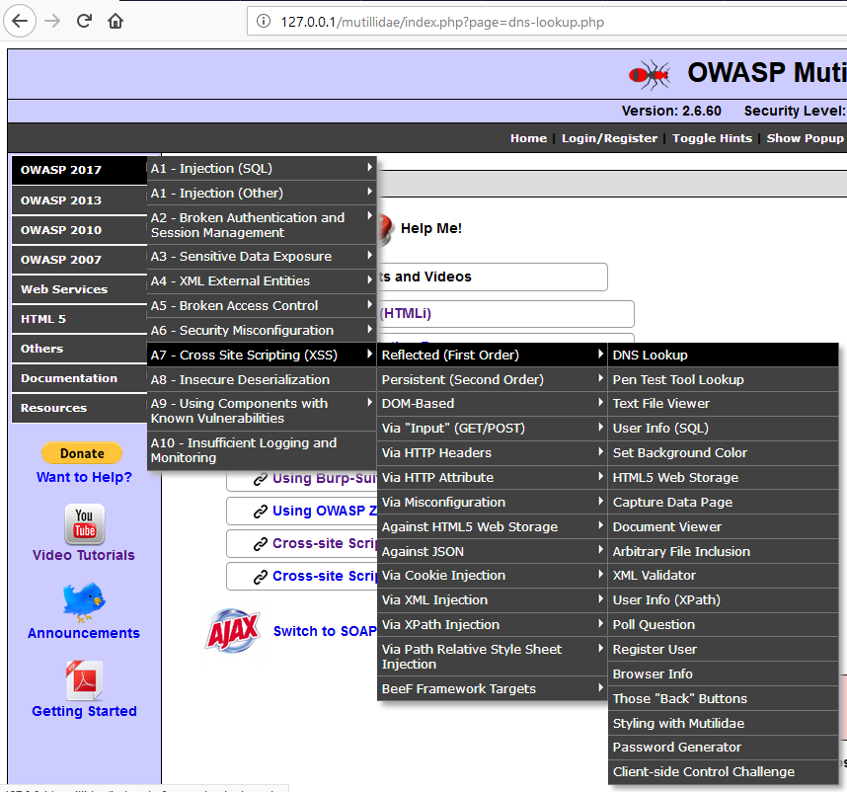
Cross Site Scripting in Mutillidae (Optional)
You had watched the video. You can now do Cross Site Scripting (XSS) attack in Mutillidae.
Refer to Hint and Videos in Mutillidae for Cross Site Scripting assistance
OWASP 2017 → A7 – Cross Site Scripting (XSS) → Reflected (First order) → DNS Lookup

Slide 15
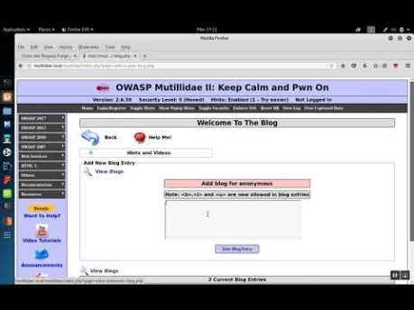
Cross Site Request Forgery Attack
Video
https://www.youtube.com/watch?v=rR0SnARknlk

Slide 16
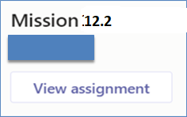
Mission 12.2
Perform cross site request forgery (CSRF) in Mutillidae
OWASP 2013 --> A8 - Cross Site Request Forgery (CSRF) --> Add to your blog
Follow the Hints and Videos → Cross-Site Request Forgery (CSRF). (refer to slide 20)
Some of the videos provided as hints are old but they still work with slight tweaking.
Do the following tasks:-
Task 1: Create a user "sammy" with password "samurai“ (Slide 17)
Task 2: Force someone to add a blog without consent (Slide 18)
Task 3: CSRF on the User Poll (Slide 19)
Write a report of your experiences performing cross site request forgery attacks on the tasks given. Attached the screenshots captured into your report.
Submit your report via the MEL assignment link.
Task #. (e.g., Task 1)
Brief description of the experience performing Task 1.
Screen shots of the attack and a very brief description of the screen shot.
Brief description on how this attack could be prevented or mitigated.

Slide 17
Task 1: Create a user "sammy" with password "samurai“
Copy Script 1 from the text file provided in the CSRF-Scripts.txt – File in MEL.
Paste Script 1 into "Add blog for anonymous"
Mouse over "Hello World" , user "sammy" with password "samurai", would be created.
Capture screenshot of your output

Slide 18
Task 2: Force someone to add a blog without consent.
Reset DB
Logout
Type "CANARY" into " Add blog for anonymous" and save blog entry
Right click "View Source", copy the source code into notepad
Save the notepad as "ForceBlogEntry.php" into XAMPP/htdocs/CSRF
Visit http://127.0.0.1/CSRF/ForceBlogEntry.php
Replace "CANARY" in ForceBlogEntry.php with Script 2
Refresh http://127.0.0.1/CSRF/ForceBlogEntry.php
Login to Mutillide as "jeremy" "password"
Visit http://127.0.0.1/CSRF/ForceBlogEntry.php and mouse over "Dancing with the stars results"
A blog entry "Add this guy to the Wall of Sheep" would be added to jeremy's blog.
Capture screenshot of your output

Slide 19
Task 3: CSRF on the User Poll
Reset DB
Logout
Type "CANARY" into "Add blog for anonymous" and save blog entry
Right click "View Source", copy the source code into notepad
Save the notepad as "ForcePollEntry.php" into XAMPP/htdocs/CSRF
Replace "CANARY" in ForcePollEntry.php with Script 3
Refresh http://127.0.0.1/CSRF/ForcePollEntry.php
Login to Mutillide as "jeremy" "password"
Visit http://127.0.0.1/CSRF/ForcePollEntry.php and mouse over "Vote for nmap. I know you will"
A forced poll entry would be made on his behalf of Jeremy.
(Refer to the scripts provide below)
CSRF-Scripts.txt – File in MEL.
Capture screenshot of your output

Slide 20
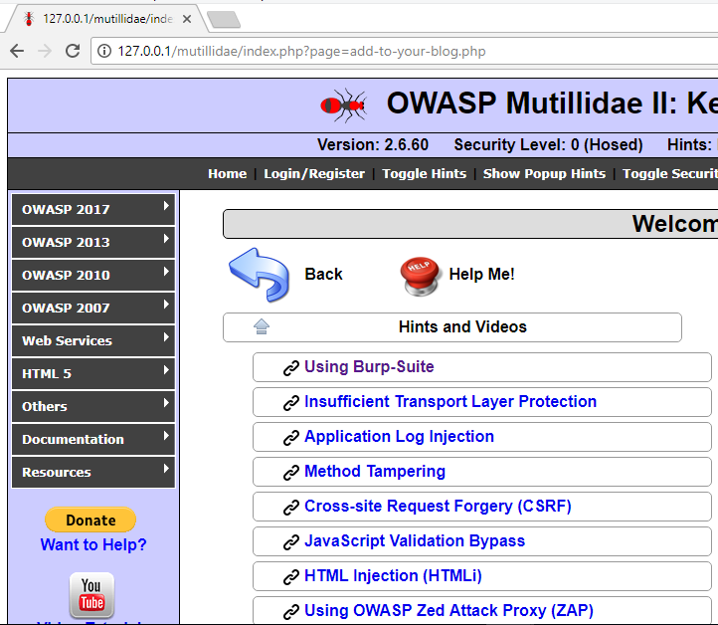
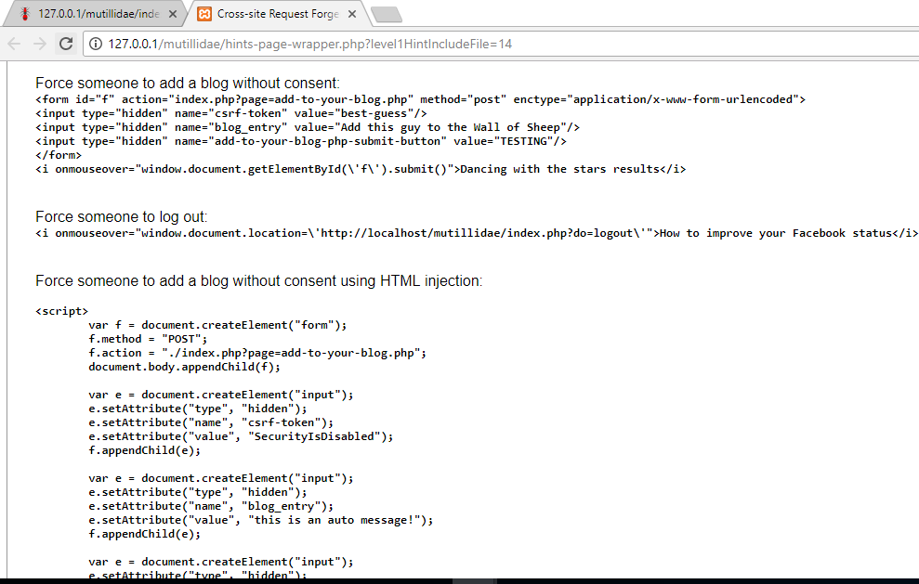
OWASP 2013 --> A8 - Cross Site Request Forgery (CSRF) --> Add to your blog

Slide 21
SQL Injection
SQL Injection
https://youtu.be/rWHvp7rUka8

Slide 22

Mission 12.3 (Optional)
Perform SQL Injection in Mutillidae
OWASP 2017 → A1 → SQLi – Extract Data → User Info (SQL)
Follow the Hints and Videos → SQL Injection (SQLi). (refer to slide 25)
Some of the videos provided as hints are old but they still work with slight tweaking.
Do the following tasks:-
Task 1: Determine if SQL injection exists (Slide 23)
Task 2: Determine number of columns in application query (Slide 23)
Task 3: SQL Injection - Others (Slide 24)
Write a report of your experiences performing SQL injection attacks on the tasks given. Attached the screenshots captured into your report.
Submit your report via the MEL assignment link.
Task #. (e.g., Task 1)
Brief description of the experience performing Task 1.
Screen shots of the attack and a very brief description of the screen shot.
Brief description on how this attack could be prevented or mitigated.
This is an optional mission.

Slide 23
SQL Injection (Task 1 & Task 2) (Optional)
Task 1: Determine if SQL injection exists
[Hint: https://youtu.be/rQ6R4B9m-nk]
Task 2: Determine number of columns in application query. Inject NULL columns until injected query works.
[Hint: https://youtu.be/UcbZUmuMy3U]
Note that the above video goes blank for a little while, however continue to listen to the commentary and the video will become visible again.

Slide 24
Task 3: SQL Injection – Others (Optional)
Task 3: [Hint: http://127.0.0.1/mutillidae/hints-page-wrapper.php?level1HintIncludeFile=10]
Attempt to determine database server brand
Attempt to determine database name
Attempt to determine schema name
Attempt to determine table(s) names
Attempt to determine column(s) names
Attempt to extract data
Attempt to read files from server
Attempt to determine database computer name, IP address, username, version, etc.
Extract passwords from user table
Dump user credentials

Slide 25
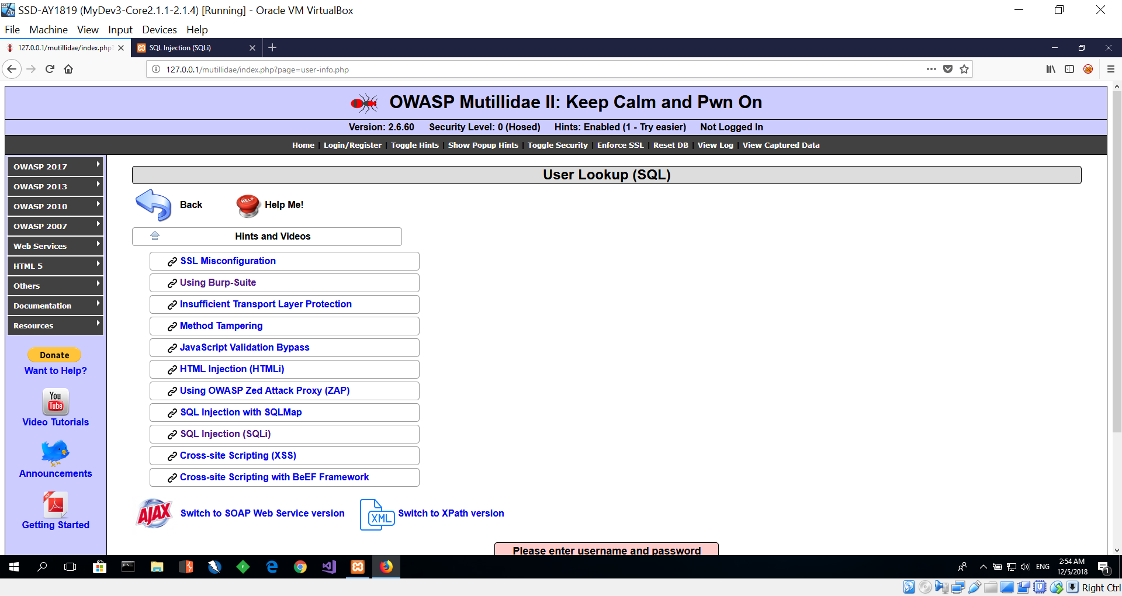
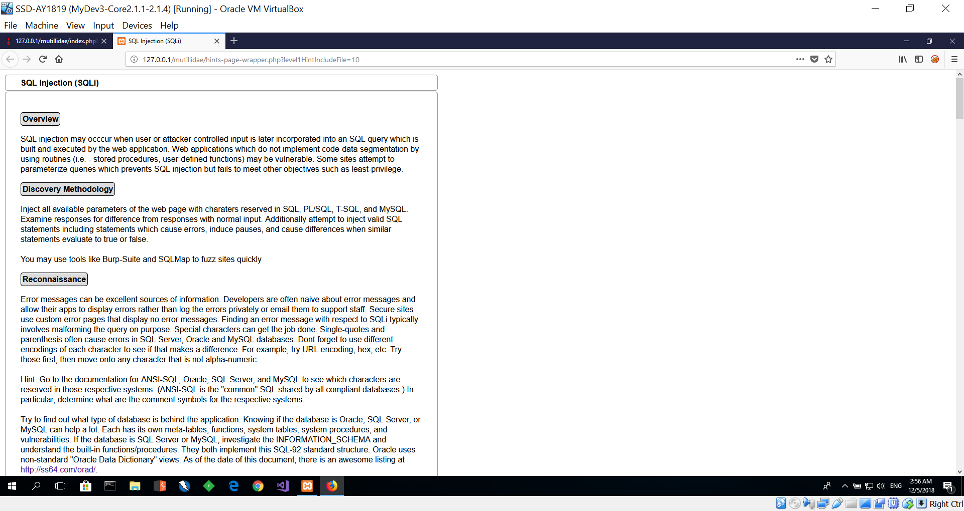
OWASP 2017 → A1 → SQLi – Extract Data → User Info (SQL)

Slide 26
Reflections - Individual
Reflect on Week 11, and Week 12 lessons
Inside your “SSD-AY2021-xxx-Pxx-Txx → Week 12”
Create another Wiki/OneNote tab “Your Name - Reflection”, and answer the following questions.
Identify 3 important learning points acquired from Week 11 & 12 lessons.
What do these learning points imply? Or what conclusions could you draw?
What will you do more of, less of, start or stop the next time? (In the context of the learning acquired thus far)
Deadline: Before the next week’s lesson

